Slide 1

Presentation
If you had your own business what kind of business would it be? (What would it have, how would it be, what would be interesting or innovative about it..?) Describe it completely.
What do you wish/hope about your company? What do you wish/hope will happen in the future?
Remember not all your speaking has to include conditional or sentences with “wish” or “hope”, you may include other tenses, there is not an exact number, but I do want you to include the content seen in Unit 1.
At least 2 minutes
Write your Youtube link or link for Google Drive
Stand Up in front of the camera, do not be close to the screen and read (point will be deducted)
Clear and loud volume
Remember it’s worth 20%
DUE: October 9th, 2020

Slide 2
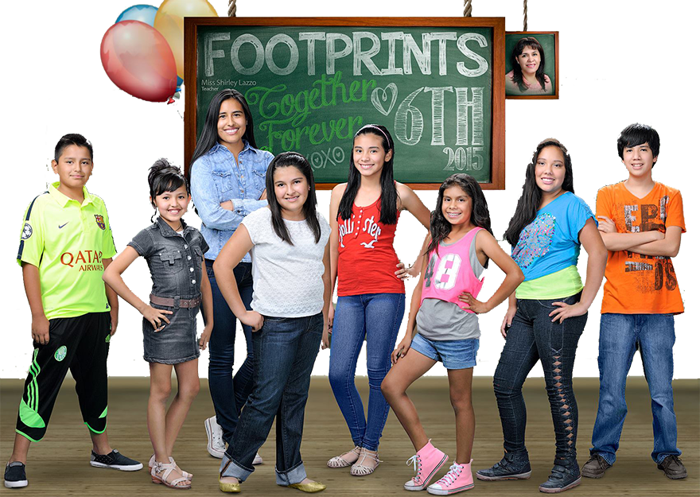

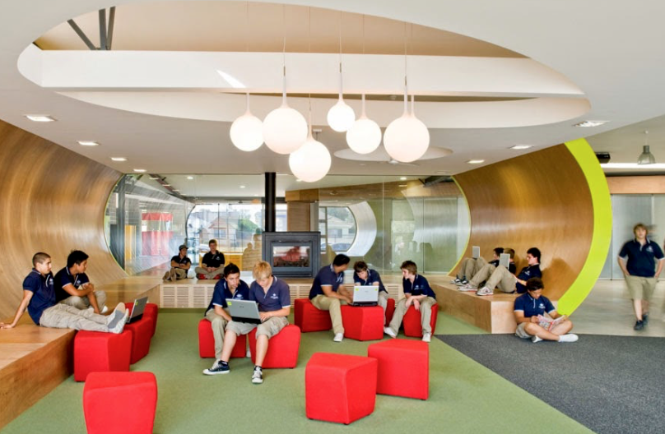

If I had my own business, it would be an English school for all ages. It would have classrooms equipped for children, adolescents, and adults. If I build this place, it would be modern, attractive and with a positive learning environment for teachers and students. The classrooms will all have technology, be very comfortable, and have everything necessary to learn a second language.
I wish I could have it right now! But I know it is not possible and I have to be patient. I hope I can plan everything well for when that day comes. I hope all my family and friends support me.
In life if we are patience and persevere in everything we dream, we can accomplish it. If I have my English school, I know I will put all my effort to make it one of the best.
Part of an example

Slide 3
Oral Presentation Rubric
 | 4 | 3 | 2 | 1 | Total
Content
Organization
Accuracy/Grammar
Fluency
Pronunciation
Comments: |  |  |  |  | Total score:

Slide 4
If I had my own business, it would be an Stress relief station for people who loves cats. It would have couches so you could seat there and pet cats. If I build this place, it would make the people fell like being home. The business would have a lot of vending machines for the people, in case they want to buy some snacks. And the best part, the cats would be stray cats and if people like them, they will adopt them. I think it would be a really nice place.
I hope I can make it true in the future a and I know it is possible and I have to be patient. Nothing in this earth can stop me. I wish I could make it so fast, but I need to be patient, maybe in 10 years I could make happen, but that we don’t know now, so let get to work!!!!!
In life people will make you face down, but this world is of people who know there are no limits for things, If you think something can’t happen, It’s because you can’t do it. But believe me, someone else will.

